Slide 1
Internationalization of Higher Education
Aparna Rayaprol

Slide 2
Objectives of the Harmony Project
To outline Partner Countries’ Higher Education Institutions (PC HEI) internationalisation landscapes and to identify levels of integration of international and intercultural dimensions into PC HEIs’ formal and informal curriculum.
To improve PC HEIs’ capabilities for internationalisation through staff trainings and by translating general awareness of the Internationalisation at Home (IaH) concept into streamlined institutional strategies and Action Plans.
To build students’ intercultural knowledge and sensitivity to cultural diversity by transforming PC HEIs’ International Relations Offices (IROs) into vibrant multicultural focal points.

Slide 3
Strategies for Internationalization
Need for synergy between national policy and institutional strategy at the level of the higher education institution
Need to develop a comprehensive strategy for internationalization at institutions
At UoH Revive and strengthen Study-in-India Program awarded the Andrew Heiskell award 2014 by the IIE
Explore cluster approach to course more interdisciplinary offerings at UoH
Revisit old institutional partnerships
Identify region-specific strategies – South & Southeast Asia, East & Southern Africa, Harmony partner institutions om EU and Asia
Collate and consolidate existing research/academic partnerships with international faculty and/or institutions

Slide 4
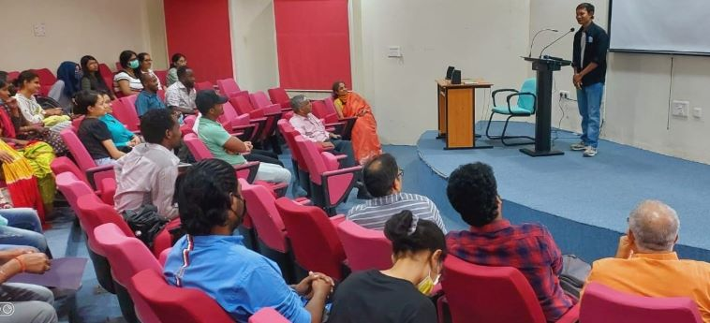
NEP Vision for Internationalization
Match National Education Policy (NEP) with Harmony Project Goals
UoH already a destination for international academic exchanges
Dual degrees and Challenges
Renew Faculty development programs
Student Mobility and Diversity
Semester and short-term SIP
Offer subject clusters

Slide 5
Curriculum development
Host institutions need to compare their courses and syllabi with international HEIs and tailor their courses to attract international students
Credit transfers through Institutional MoUs and Agreements
Short term programs to attract foreign students
Online courses through Digital learning
UoH has the CDLTR and CDVL that host courses online
Offer new courses to compete with international institutions

Slide 6
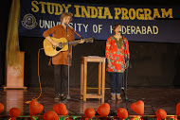
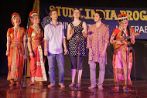
The SIP at Uoh: 1998 to 2022 A Model for all
Provided international students opportunities to experience an Indian academic environment in the classroom
Offered interdisciplinary perspectives on history, politics,
development, and society in contemporary India
Integrating international students
Through orientation and cultural immersion
Into a safe campus
On the football field
Into Host Families
Through continued academic networking

Slide 7
Some Partnerships
Fulbright Researchers and Faculty
Two faculty and 3 researchers in 2022
Namaste plus Germany Cultural Exchange between Goettingen University and Indian Universities in 2020 and 2021.
Freie University 4 PhD researchers (1 semester) and two Staff to Berlin in June 2022
UoH a partner in the Harmony project led by University of Zaragoza, Spain with 7 other countries in the EU and Asia

Slide 8
Some Outcomes
Organisation and realisation of the dissemination events at an institutional level
The Uoh organised one workshop on internationalization for senior adminstrators on December 19, 2022 and plans another in 2023
https://herald.uohyd.ac.in/workshop-on-internationalisation/
Publication of articles about project-related events in the institutional newspapers

Slide 9
Some Ongoing MoUs
University of Zaragoza, Spain
Portland State University, Portland, USA
Freie Universitat, Berlin
University of Springfield, Illinois,USA
Linnaeus University, Sweden
Okayama University, Japan
Asia University, Taiwan
University of Dhaka, Bangladesh
University of Saskatchewan, Sasktoon, Canada
University of Bordeaux, France
Finnish Meteorological Institute, Helsinki, Finland
University of Aizu, Japan
National Tsing Hua University, Taiwan
Georg August Universitat Goettingen, Germany
National Cheng Kung University, Taiwan
Universidad Catolica del Maule, Talca, Chile

Slide 10
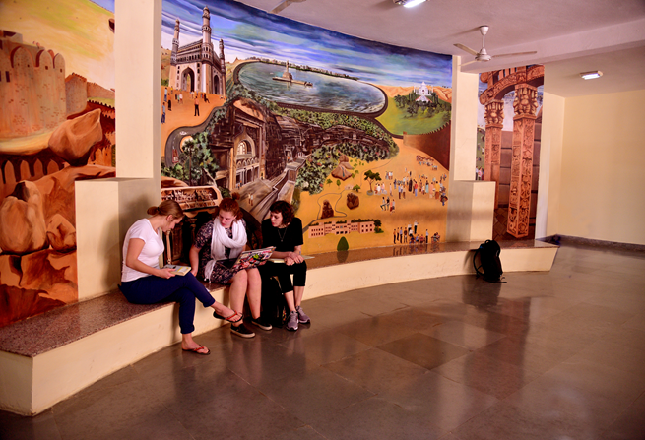
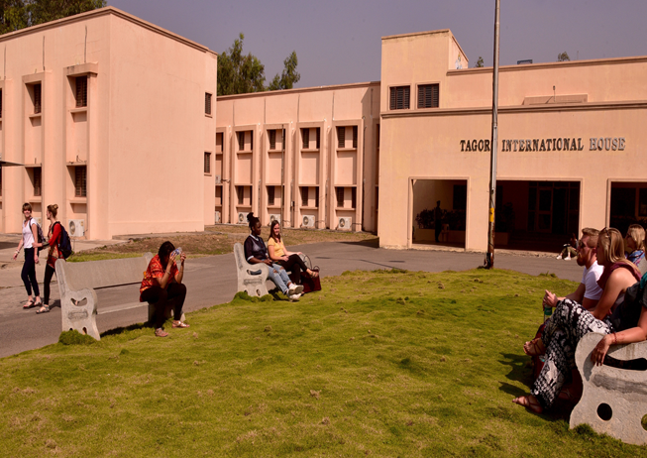
Infrastructure : Tagore International House

