Slide 1
Towards Intercultural Engagement and Cultural Diversity through FRIENDS Teahouses Operation and Digital Storytelling HARMONY National Conference and Project Consortium Meeting 3 November 2022
Christina Armutlieva
Varna University of Management, Bulgaria

Slide 2
FRIENDS and HARMONY
Internationalisation at Home (IaH) across Asia
IaH State of the Art Infographics
IaH Capacity Building Webinars
Digital Storytelling
FRIENDS Teahouses
Student Boot Camp

Slide 3
FRIENDS – HARMONY: FRIENDS Teahouses and Digital Storytelling Component
FRIENDS Specific Objectives | HARMONY Specific Objectives
1. To build students’ intercultural knowledge and sensitivity to cultural diversity through the introduction of an Intercultural Passport virtual module into PC HEIs’ elective formal curriculum. 2. To transform IROs into vibrant multicultural focal points through the establishment of FRIENDS Teahouse. | 1. To build students’ intercultural knowledge and sensitivity to cultural diversity through digital storytelling. 2. To transform IROs into vibrant multicultural focal points through the establishment of FRIENDS Teahouse.

Slide 4
FRIENDS Teahouses
Mission, vision, values
Home Away from Home Programme
Digital storytelling: mentoring, support, assessment
Intercultural festivals, social gatherings, cultural events
Management and daily operation.

Slide 5
3.3.4. FRIENDS Teahouses Timeline
ACTIVITY | RESPONSIBLE | DEADLINE | REMARKS
1. Evidence of formal establishment | All 7 Asian HEIs | 21.11.2022 | Readable soft copies of official documents accompanied by unofficial translation in EN in Trello
2. FRIENDS Teahouses on HEIs Organizational Charts | All 7 Asian HEIs | 21.11.2022 | Readable soft copies of official documents accompanied by unofficial translation in EN in Trello
3. FRIENDS Teahouses’ Code of Conduct/ Operational Guidelines | All 7 Asian HEIs | 28.11.2022 | Readable soft copies of official documents accompanied by unofficial translation in EN in Trello
4. FRIENDS Teahouses’ Event Calendars as of 28.11.2022 | All 7 Asian HEIs | 28.11.2022 | Readable soft copies of official documents accompanied by unofficial translation in EN in Trello
5. Official Opening ceremony and events | All 7 Asian HEIs | 28.02.2022 | Events’ complete evidence to be uploaded in Trello

Slide 6
Storytelling and Effective Learning
Storytelling as an effective vehicle for influence
Tool for connection and engagement
Learning through storytelling
Appealing to all sorts of learners
Conveying learning that sticks
Risk-free learning
Inspiring motivation
Source: https://www.harvardbusiness.org/what-makes-storytelling-so-effective-for-learning/

Slide 7
Digital Storytelling in a Nutshell
“…digital storytelling combines the best of two worlds: the "new world" of digitised video, photography and art, and the "old world" of telling stories.”
Dana Atchley, Digital Storytelling pioneer

Slide 8
Digital Storytelling in a Nutshell
Traditional storytelling’s storyteller-listener approach versus digital storytelling using computer-based tools
Uses multimedia tools to bring narratives to life
A short form of digital media production that allows everyday people to share aspects of their story
A multimedia presentation combining a variety of digital elements within a narrative structure (a story)
Empowers students to become confident communicators and creators of media and
Helps students to gain essential 21st-century literacy skills.

Slide 9
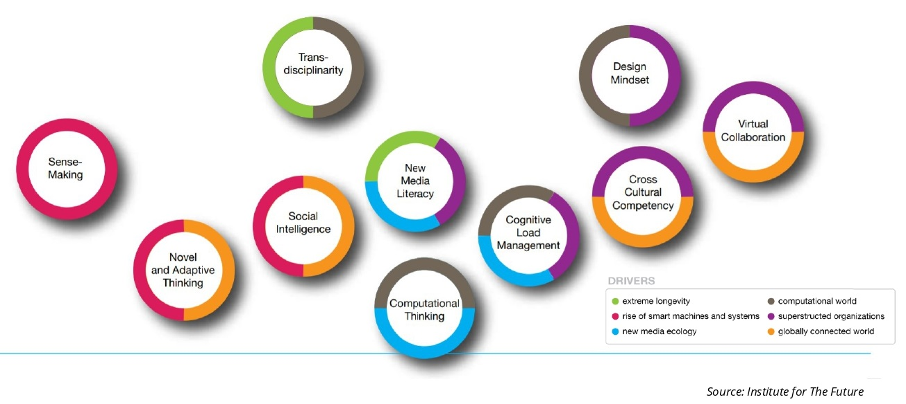
Future Work Skills 2020

Slide 10
3.3.1. Digital Storytelling: A How-To Manual
Aims to equip the students with initial knowledge and basic skills necessary for the elaboration of an interesting and inspirational digital story
Provides instructions and insights into the process of elaboration
Details the assessment criteria and procedures
Storytelling and storyboard
The writing process
The power of visuals
The role of digital media

Slide 11
3.3.2. Digital Storytelling Contests
ACTIVITY | RESPONSIBLE | DEADLINES | REMARKS
1. Digital Storytelling Contest announcement | All 7 Asian HEIs | 14.11.2022 | Online and offline at all Asian HEIs
2. Ongoing promotion of the Digital Storytelling Contest | All 7 Asian HEIs | 14.11.2022 – 28.02.2023 | Online and offline promotion at the 7 Asian HEIs
3. Digital Storytelling Contest: consultations and support to students | All 7 Asian HEIs | 14.11. – 31.01.2023 | 7 Asian HEIs IROs
4. Digital Storytelling Contest: drafting, crafting, editing, finalizing | All 7 Asian HEIs | 14.11.2022 – 28.02.2023 | Digital stories’ development, pre-production, production and post-production by all Asian HEIs’ students
5. Deadline for online submission of students’ digital stories | All 7 Asian HEIs | 28.02.2023 | At least 105 digital stories submitted
6. Digital Storytelling Contest: assessment | All 7 Asian HEIs | 31.03.2023 | Online and offline at all Asian HEIs
7. Digital Storytelling Contest: results publication online | All 7 Asian HEIs | 01.04.2023 | Lists of approved Student Boot Camp participants sent to VUM (3 per Asian HEI)

Slide 12
3.3.3. Student Boot Camp
ACTIVITY | RESPONSIBLE | DEADLINE | REMARKS
1. Student participants’ soft passport copies submission to VUM | All 7 Asian HEIs | 03.04.2023 | Readable copies of valid student passports
2. Visa invitation letters (originals and soft copies) sent to all 7 Asian HEIs | VUM | 14.04.2023
3. Visa applications submission | All 7 Asian HEIs | 17.-28.04.2023 | Detailed visa application info to be provided by VUM
4. Flight tickets purchase | UniZar | 16.07.2023 | Bulk purchase
5. Asian students arrival to VUM | All 7 Asian HEIs | 02.07.2023 | Arrival to Varna Airport
6. Boot Camp conduct | VUM | 03.-14.07.2023 | At VUM premises in Varna or Dobrich
7. Asian students departure from VUM | VUM | 15.07.2023

Slide 13
Thank you for your time and attention. Questions?
FRIENDS website:
www.erasmusplusfriends.eu
Email addresses:
christina.armutlieva@vumk.eu

