Slide 1
VT-NMIMS Strong fruitful Partnership
Dr. Sharad Mhaiskar
PVC, NMIMS
sharad.mhaiskar@nmims.edu

Slide 2
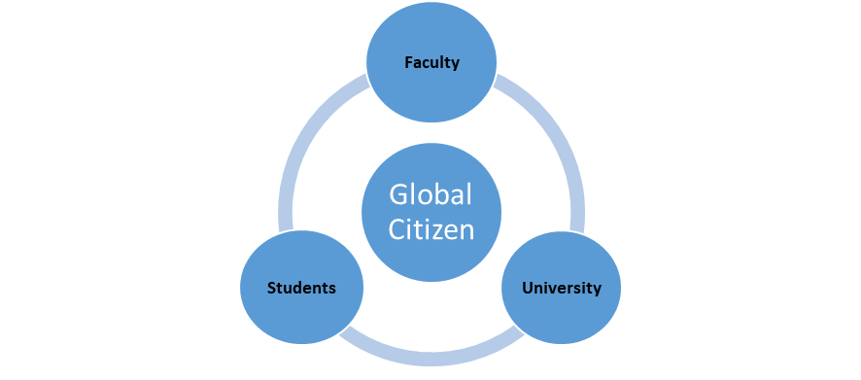
ASIA
EUROPE
S T Mobility
L T Mobility
35+ Universities

Slide 3
NMIMS VT Partnership Range of Collaboration
NMIMS VT
MPSTME M.Tech.
B.Tech.
311 program
IGE
SOE
SBM

Slide 4
NMIMS VT Partnership
NMIMS VT Institute for Global Education (IGE) and Curriculum Innovation
IGE launched – 1, July 2021
Fosters collaboration on education and research while providing faculty development opportunities
A research portfolio that is adaptive and responsive to contemporary problems
Artificial Intelligence, Data Science and Cybersecurity.
Recruit International Faculty
Recruit Ph.D. students
Craft Degree and Non-Degree Programs
BTech – Data Science, Cyber Security, Artificial Intelligence
M.Tech Data Science
Integrated MS, BS, B.Tech program in Business Analytics and Cybersecurity – 311 program
PhD Program in Computer Science (Data Science, Artificial Intelligence, Cybersecurity)
Dual Degree Masters Program – Economics

Slide 5
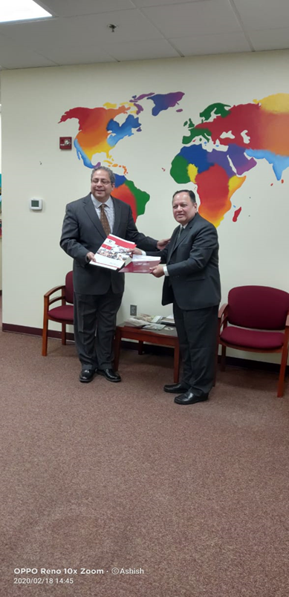
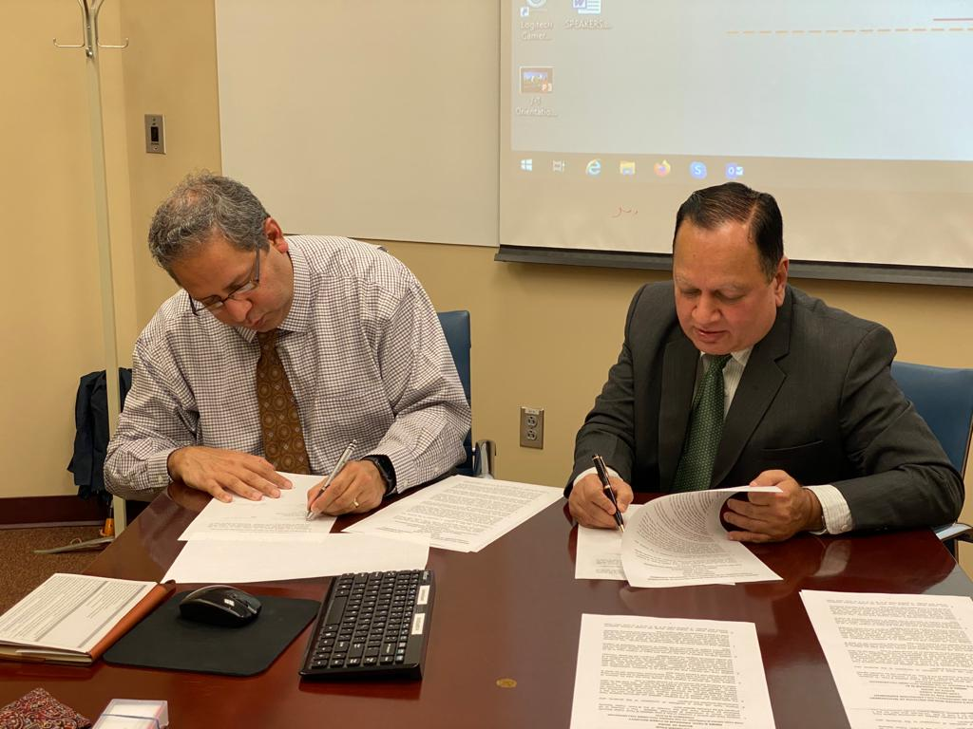
Memories of the journey

Slide 6
NMIMS VT Partnership Key To Success
Commitment and blessings of top management from both sides
Group of people committed to take the initiative to the ground
Will to tide over problems arising out of the niggling issues
Exposure to the HE systems normally gained through programs like EU harmony project, Fulbright scholarships
Urge to look beyond normal initiatives - Thinking of initiatives which will lead to win-win situations for all partners

Slide 7
THANK YOU

