Slide 1
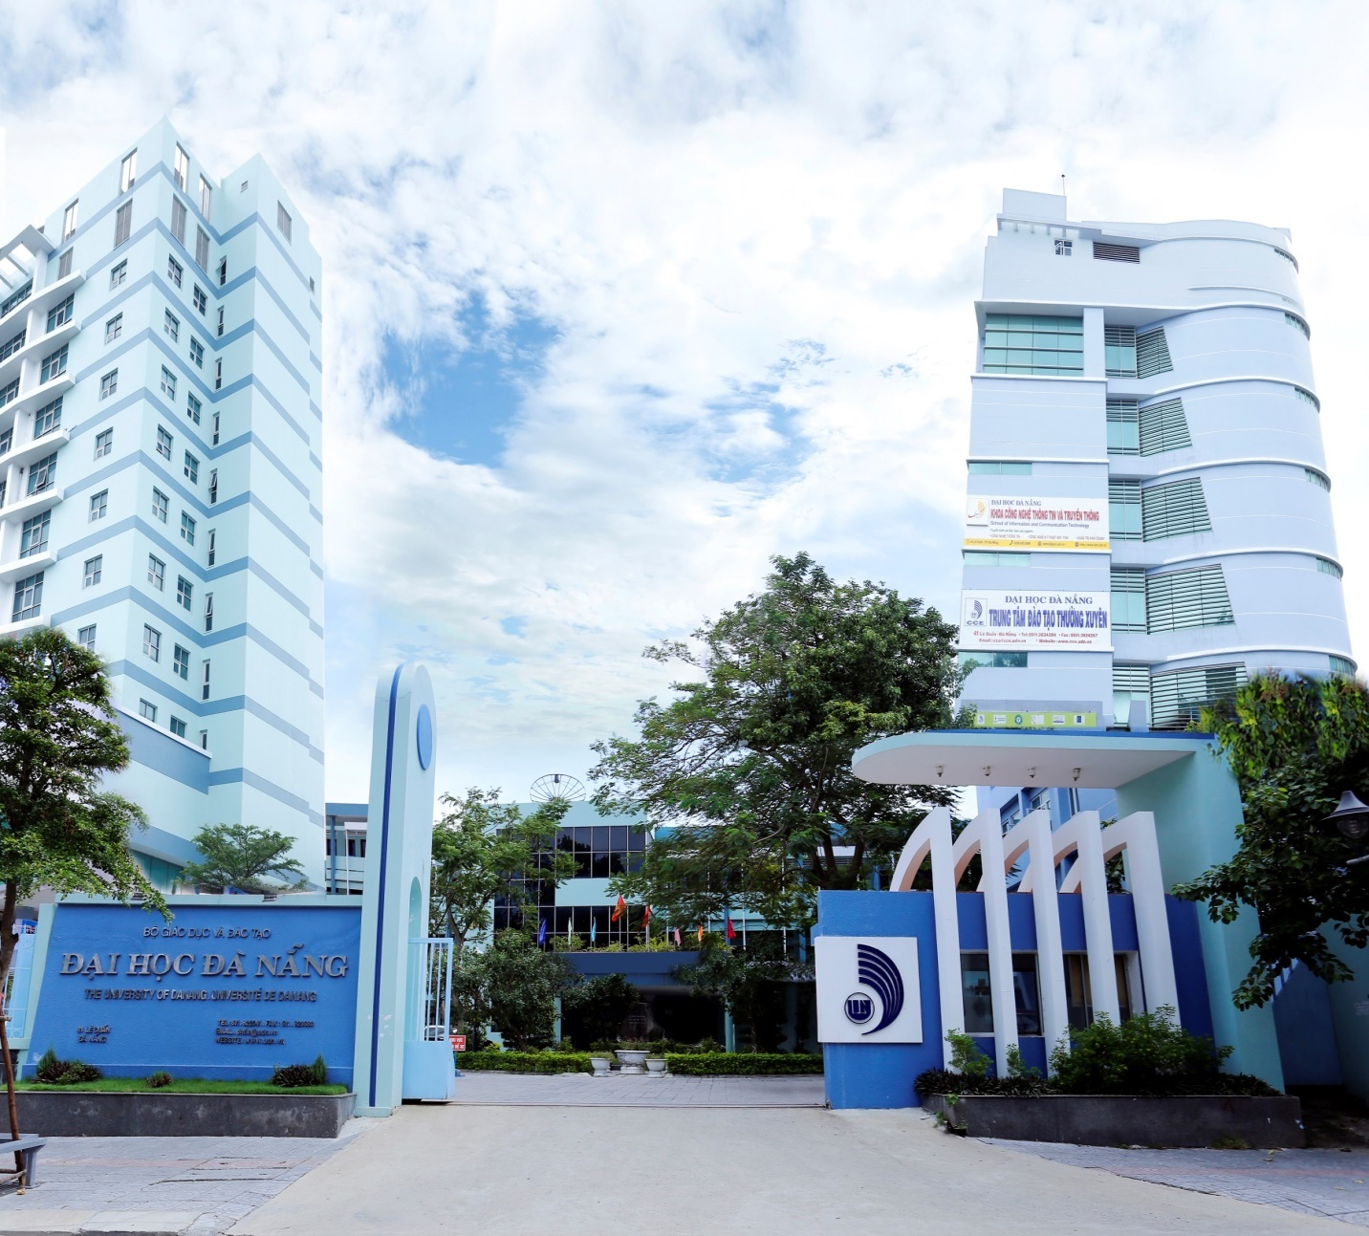
THE UNIVERSITY OF DANANG (UD)
Internationalization - Successful lessons and challenges at the University of Danang,Vietnam
23/03/2022
Assoc. Prof. Dr. Le Quang Son, Vice President
MA. Ho Long Ngoc, Vice Director, Department of International Cooperation

Slide 2
THE UNIVERSITY OF DANANG
The University of Danang is one of the three regional universities of Vietnam. - The largest multi-level, multi-disciplinary university in the central area and Western Highlands of Vietnam - The Vietnamese Government Office has just issued Official Letters dated January 18, 2022 relating to developing the University of Danang (UD) into the Vietnam National University (VNU), Danang in the coming time.

Slide 3
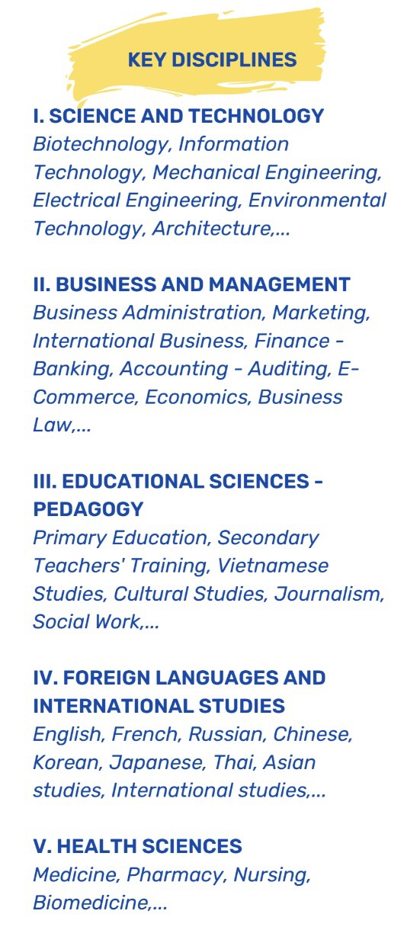
The University of Danang has affiliated members:
UNIVERSITY OF SCIENCE AND TECHNOLOGY
UNIVERSITY OF ECONOMICS
UNIVERSITY OF SCIENCES AND EDUCATION
UNIVERSITY OF FOREIGN LANGUAGE STUDIES
UNIVERSITY OF TECHNOLOGY & EDUCATION
VIETNAM – KOREA UNIVERSITY OF INFORMATION & COMMUNICATION TECHNOLOGY
UD’CAMPUS IN KONTUM
SCHOOL OF MEDICINE AND PHARMACY
VIETNAM-UK INSTITUTE FOR RESEARCH & EXECUTIVE EDUCATION

Slide 4
UD grants degrees and certificates in all levels
31 Doctoral programs
45 Master programs
139 Bachelor programs

Slide 5
Various dimensions of internationalization at UD
Internationalisation in Management and Administration
Internationalisation in Training, Education, Accreditation
Internationalisation in Research, Projects

Slide 6
Internationalization in Management and Administration
Through international cooperation and interaction in education and research, management and administration system has been sharply improved
Capacity building in management
The supports of leadership for internationalization in various dimensions : training, research, quality assurance etc

Slide 7
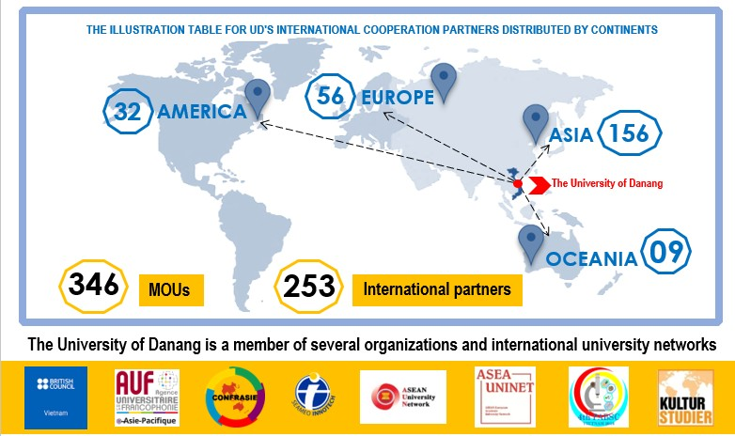
Internationalization in Administration and Management
Clear objectives to enhance education and research, continuously expand partnerships, networks

Slide 8
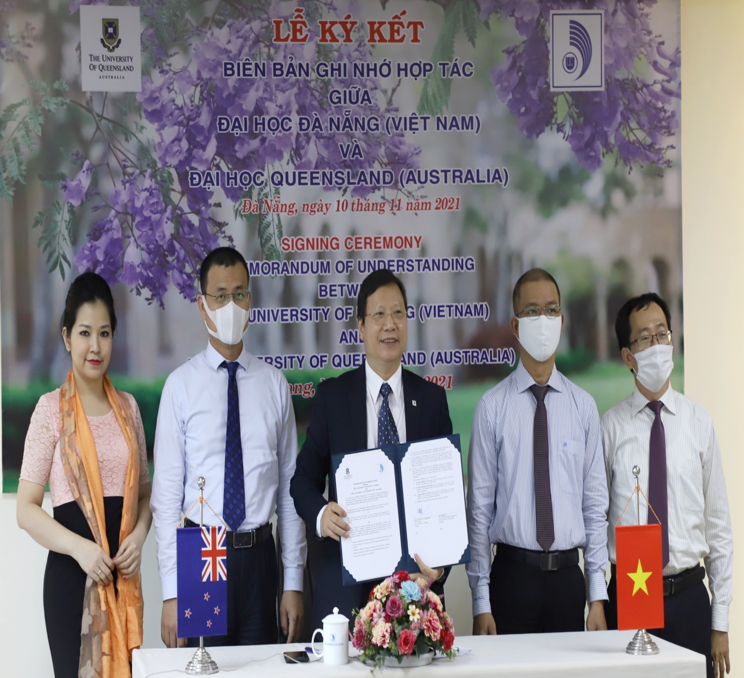
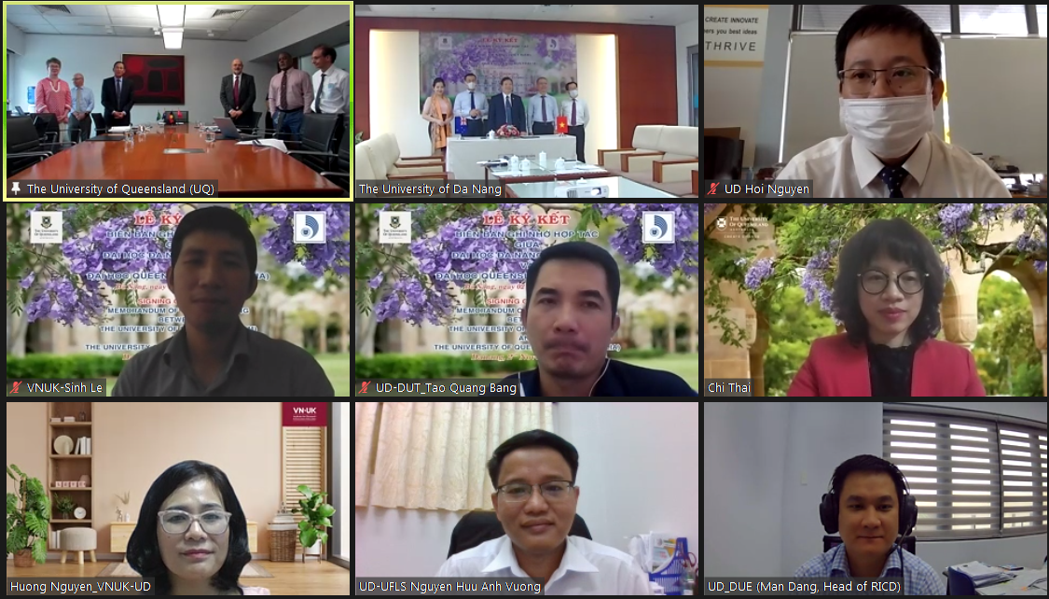
The University of Danang virtually signed a cooperation agreement with the University of Queensland, Australia

Slide 9
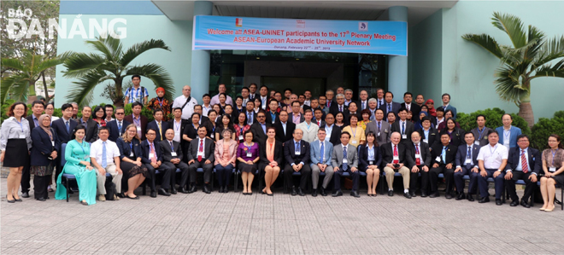
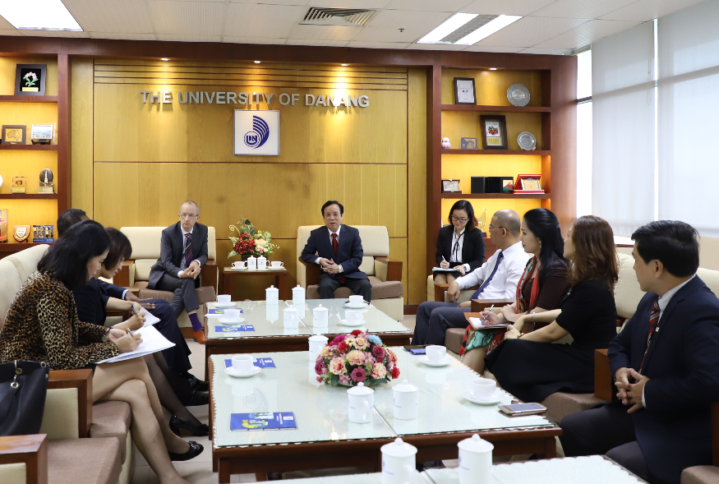
Internationalization via Network meetings, Alumnis, Intercultural partnerships
President of the University of Danang (UD) hosted the meeting with Prof. Jean-Marc Lavest (Director of the Asia – Pacific Region, Francophonie University Association – AUF
The 17th ASEAN European Academic University Network (ASEA-UNINET) Plenary Meeting took place at the University of Da Nang

Slide 10
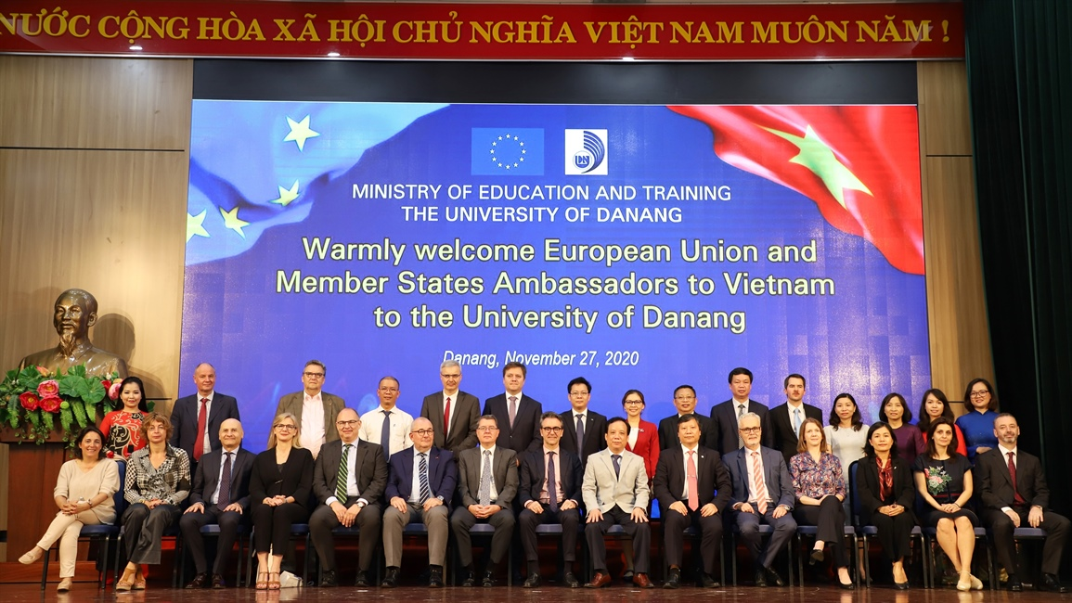
Meetings with EU Ambassador and Member States Ambassadors to constantly strengthen and nurture the relationship and intensive cooperation for sustainable development between UD and international partners, positively contributing to the integration process to the world higher education.

Slide 11
MEMORANDUM OF UNDERSTANDING/AGREEMENTS WITH EUROPEAN PARTNERS
European partners
9 France
1 Belgium
4 Czech Republic
11 The UK
3 Finland
5 Germany 2
European partners
2 Italy
3 Norway
1 Portugal
3 Russia
2 Spain
Rumani

Slide 12
Internationalization in Training and Education
Articulation programs
Dual/Joint programs
Advanced/High-quality programs

Slide 13
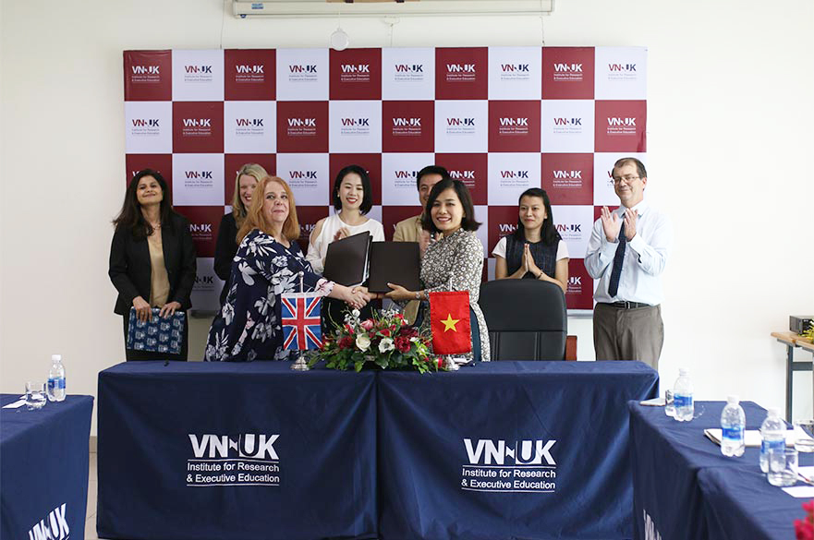
Internationalization in Training and Education
UD-VNUK cooperated with Nottingham Trent University (NTU) recently launched a joint MA TESOL (Teaching English to Speakers of Other Languages) program to help students in Vietnam access the UK’s prestigious education system.

Slide 14
UD has more than 30 training programs accredited to achieve international standard (CTI of Europe, and AUN-QA of Southeast Asia), ranked 03rd in the whole country in terms of number of accredited training programs

Slide 15
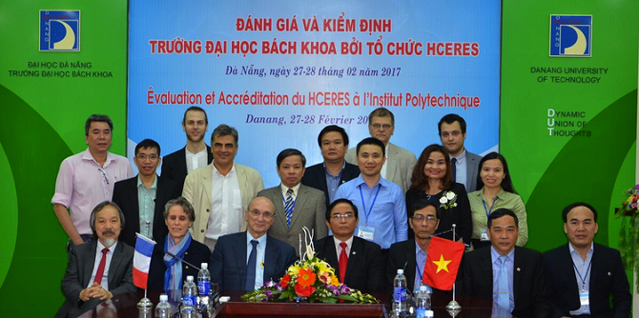
Internationalization in Training and Education:

Slide 16
Development and adoption of educational programs and curriculum materials
ORGANIZATION | MAJOR | LEVEL AND FORM OF TRAINING | PARTNER
UINVERSITY OF SCIENCE AND TECHNOLOGY | Industry Informatics | Undergraduate | Lycée Louis Legrand Paris University, France
 | Civil Engineering | Undergraduate | Nagaoka University of Technology, Japan
 | Chemical Technology | Undergraduate | University of the South - Toulon - Var, France
 | Information Technology | Undergraduate | University of the South - Toulon - Var, France
 | Advanced program: Digital System | Undergraduate | University of Washington, Seattle, United States
 | Advanced program: Embedded System | Undergraduate | Portland State University, Oregon, United States
Advanced training programs are properly designed on the basis of the curricula
currently used at prestigious universities in the
world, including content, teaching method,
organization and training management
processes and are taught in English

Slide 17
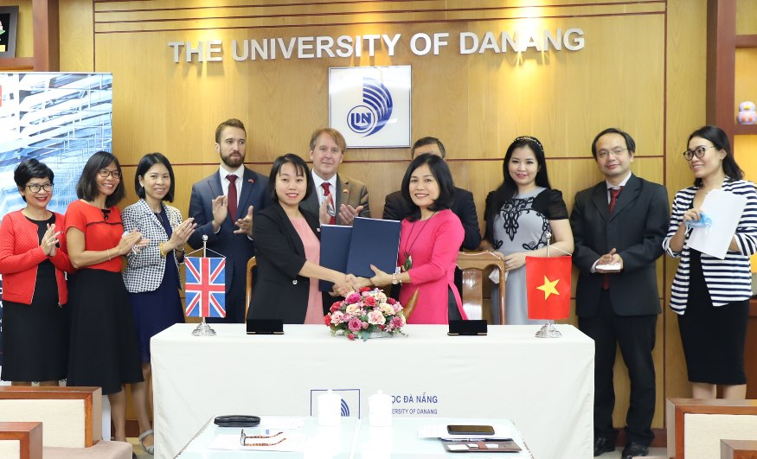
IBM (International Business and Management) at UD-VNUK is consulted by top 30 UK, Aston University, who are recognized worldwide for this business programs.
The VN-UK Institute for Research and Executive Education (VNUK), UD signed a cooperation agreement with the British Association of Chartered Certified Accountants (ACCA).

Slide 18
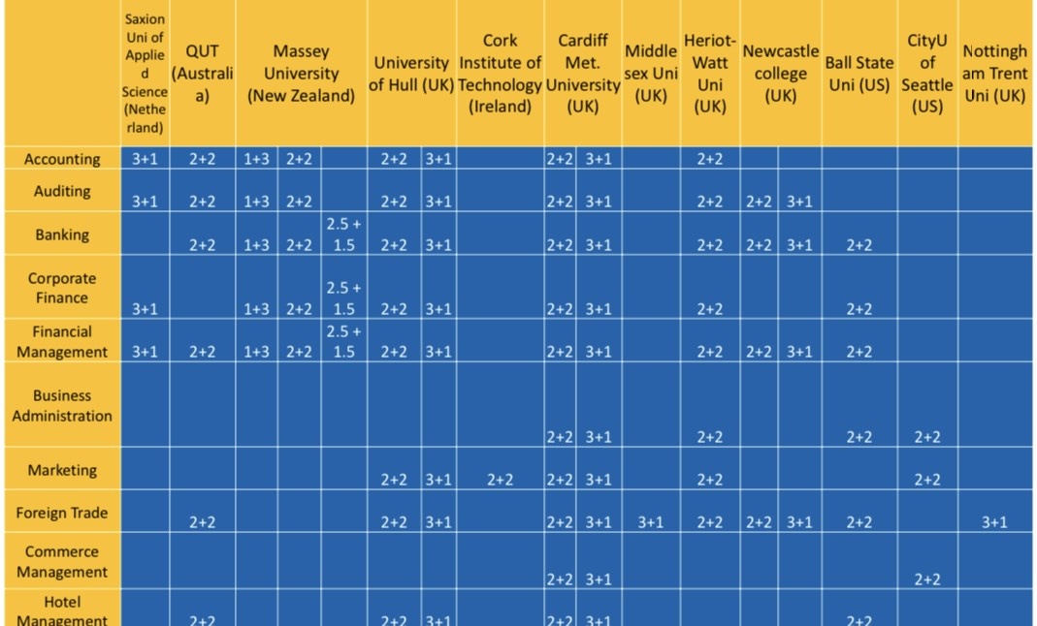
Development and adoption of educational programs and curriculum materials
EXAMPLE OF SOME SUCCESSFUL TRANSFER PROGRAMS AT UD-DUE

Slide 19
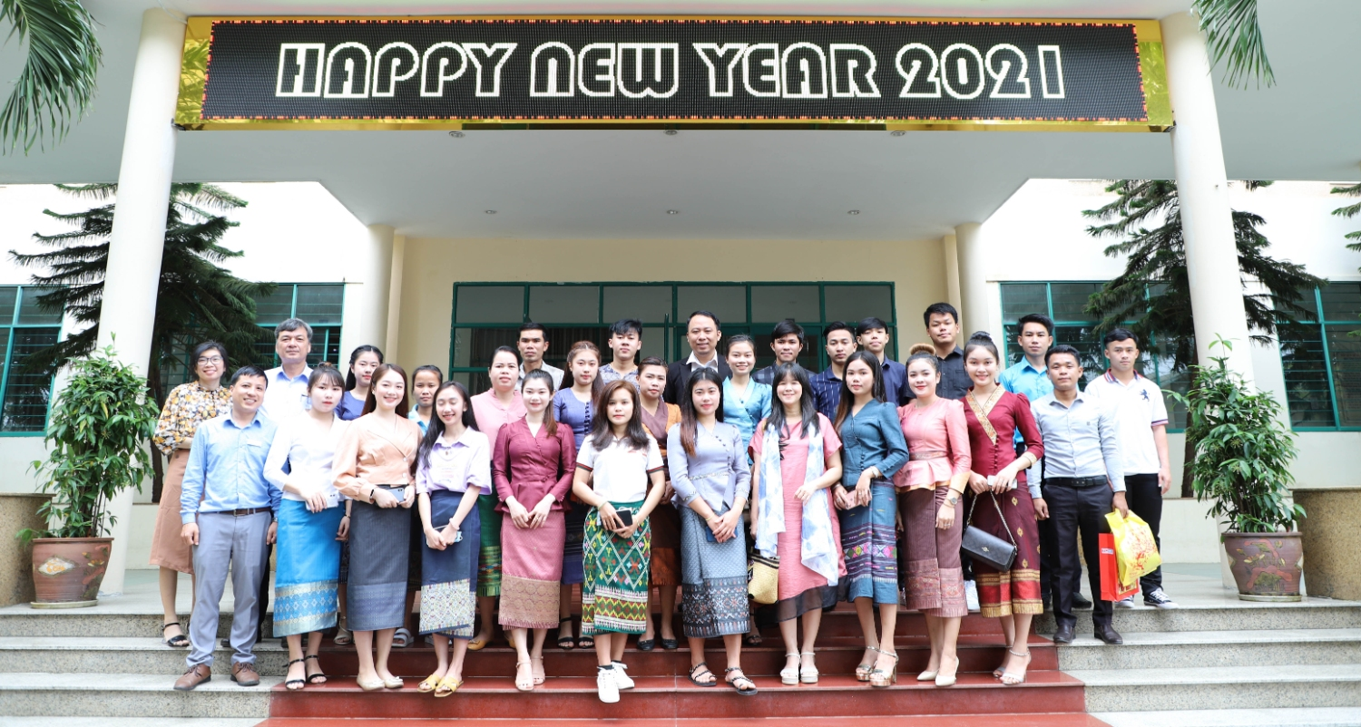
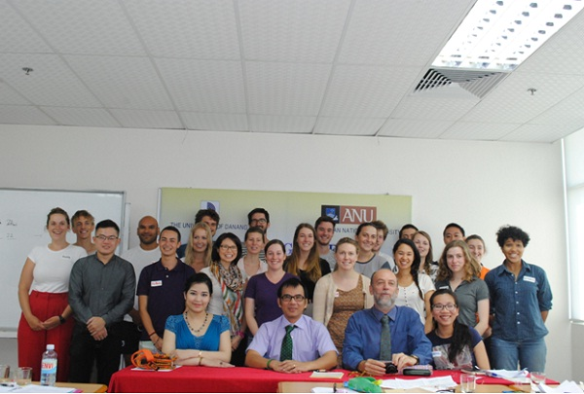
Number of International students: more than 600 students from Laos, Korea, French, UK, Japan, Russia, Germany, U.S.A….

Slide 20
Internationalisation in Research and Projects
Research
Higher-quality research: more ISI papers
Increased international scientific workshop/conference
Increased cooperation and contacts with international industries
Exchange of students for graduate theses or staffs for research project leading to capacity building enhancement

Slide 21
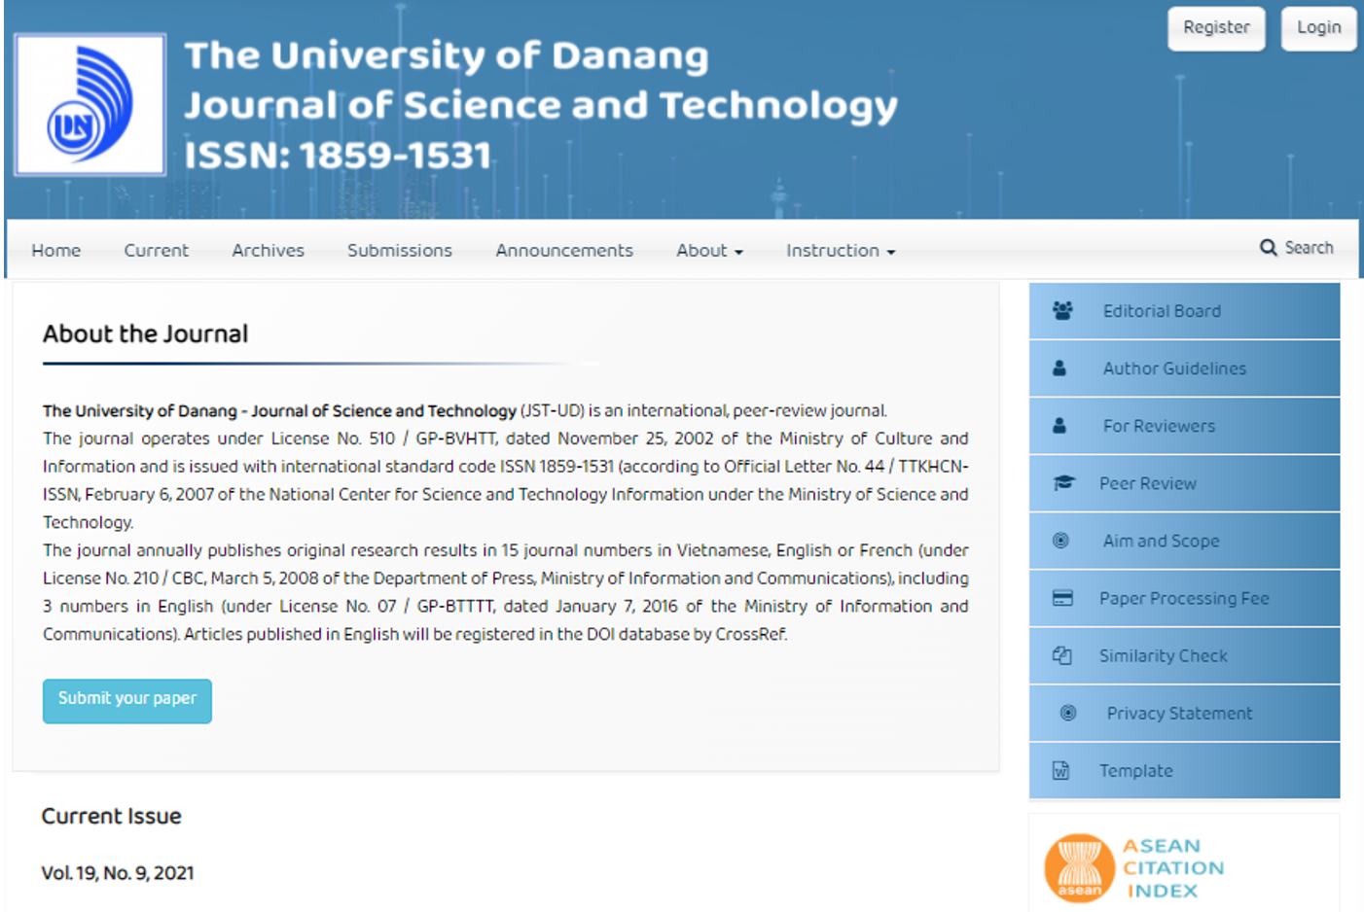
Better performance in international publications year by year. The number of WoS/Scopus journal articles of UD in 2021 is about 520 (an increase of about 15% compared to the previous year, the University of Science and Technology alone increased 40%, the University of Education increased by 29%).
Scientific publications contribute to bringing the University of Economics to the top 6 according to the ranking of economic research institutions (RePEc) of Vietnam.
The Journal of Science and Technology of UD has been included in the list of citations in Southeast Asia (ASEAN Citation Index).

Slide 22
The Da Nang International Institute of Technology (DNIIT) was established thanks to the fruitful cooperation of the University of Danang, the Université Côte d'Azur Initiative of Excellence (IDEX) and the Francophone University Agency (AUF).
DNIIT is an international collaborative platform that drives project-teams which extending to innovation and training activities. It is therefore a question of proposing a new type of international collaboration with a view to building true thematic ecosystems focused on solving societal problems

Slide 23
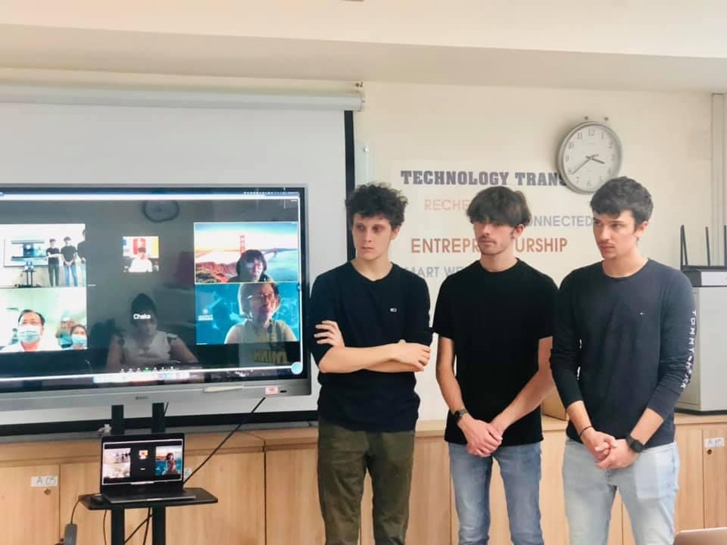
Team-Projects ECARE: Big Data and E-health Applications
Equipe-Projets EMOTICA: Emotion Capture
Equipe-Projets MAVAK: aimed at further exploiting this research work, by extending the operation of the already existing IoT platform on various application, making the device suitable for smart-city, smart-farming or e-health applications. To this end, three main activities will be carried on: the modification of the antenna, the variation of the shape of the device to better fit with application and the use of various energy harvesting systems (thermo-electric generator, mechanical or solar cell)
Equipe-Projets POSCA: Pollution Scanning
Equipe-Projets SLEGO: Specific domain Language for Experience Global Orchestration
Students of Uni of Côte D’Azur defensed their thesis proposal at UD

Slide 24
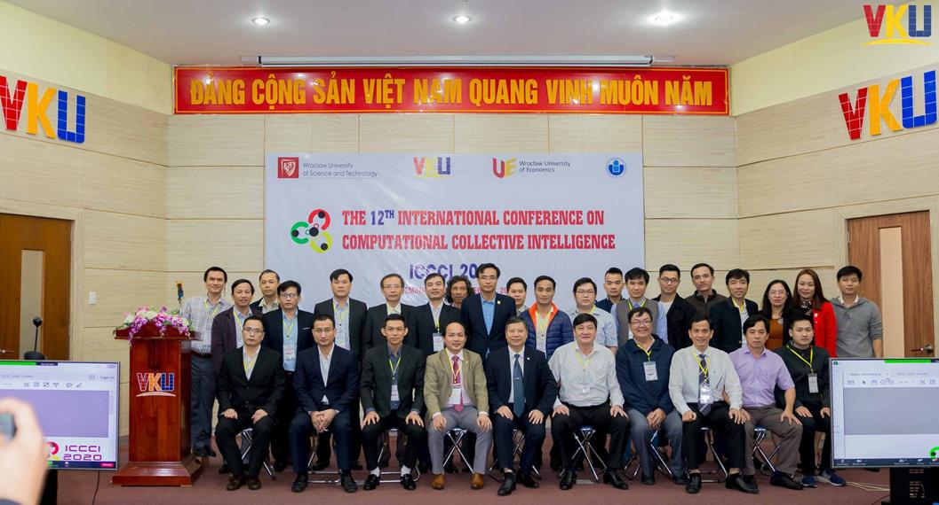
International scientific workshop/conference
2021: 27 international conference were held in spite of negative affect of Covid 19 pandemic
12th International Conference on Computational Collective Intelligence Conference at UD-VKU

Slide 25
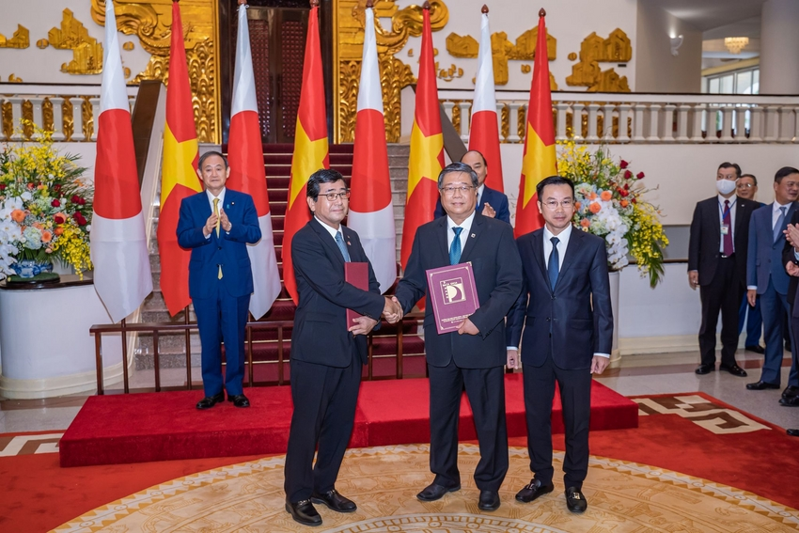
FUJIKIN and UD- DUT signed cooperation agreement of "Fujikin Danang R&D Center" Project, built in Da Nang Hi-Tech Park within the witness of the Prime Ministers of the Japan and Vietnam. FUJIKIN will cooperate with UD-DUT to strengthen the research and training excellent human resources for advanced technology development such as:
- Different type of of robots (including unmanned aerial vehicle)
- Next generation high technology medical equipment
- Hydrogen energy
- New technology by using LED
- New information and communication technology
- Smart city, nano-material, most advanced material

Slide 26
ERASMUS+ KA1: INTERNATIONAL CREDIT MOBILITY
1
FRANCE
Université Côte d'Azur (2017-2020)
Outgoing
+ 02 Staff
+ 01 PhD student
Université Nice Sophia Antipolis (2014 – 2020)
Outgoing:
+ 14 Staff
+ 11 PhD student
+ 03 Master student
+ 05 Bachelor student
Incoming:
+ 03 Staff
+ 05 PhD student
+ 05 Master student
+ 12 Bachelor student
Université polytechnique des Hauts-de-France (2017 – 2019)
- Outgoing:
+ 08 Staff
+ 01 PhD Student
+ 01 Bachelor Student
- Incoming
+ 06 Staff
2
ROMANIA
Politehnica University of Bucharest(2017-2019)
Outgoing:
+ 02 Staff
+ 01 PhD student
- Incoming:
+ 02 Staff
Universitatea Babeş-Bolyai (2017 – 2022)
- Outgoing:
+ 05 Staff
+ 4 students
HUNGARY
Óbuda University (2016 – 2021)
- Outgoing
+ 10 Staff
+ 08 PhD and Master Staff
Incoming
+ 06 Staff
+ 02 Bachelor Student
3

Slide 27
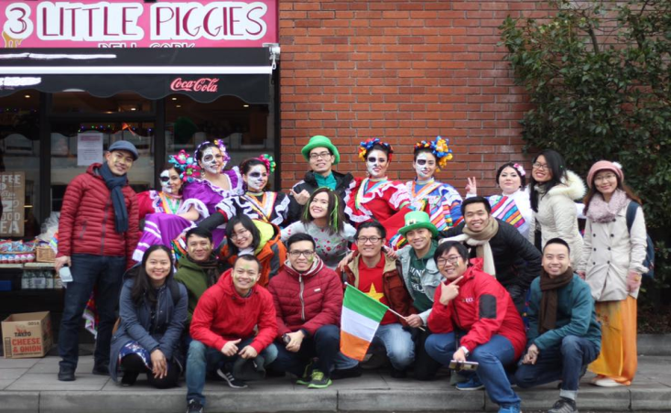
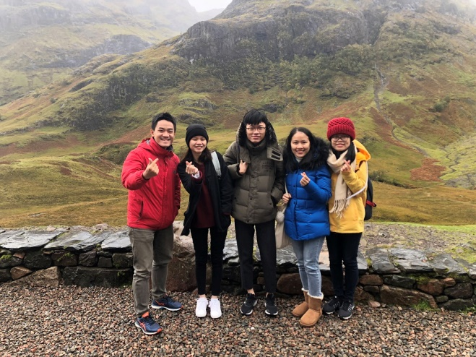
ERASMUS+ KA1: INTERNATIONAL CREDIT MOBILITY
4
POLAND
University of Warsaw (2017-2019)
Outgoing
+ 01 Staff
WSB University (2016 – 2022)
Outgoing
+ 05 Staff
- Incoming:
+ 01 Staff
GERMANY
Ludwig-Maximilians-Universität München (2017 – 2019)
Outgoing
+ 02 PhD student
Westphalian University of Applied Sciences (2017 – 2019)
Outgoing:
+ 02 Staff
+ 19 Bachelor student
Incoming:
+ 02 staff
6
SPAIN
Universitat Politècnica de València (2014-2021)
Outgoing
+ 06 Staff
Incoming
+ 02 Staff
5

Slide 28
ERASMUS+ KA2: CAPACITY BUILDING
1
HUB4GROWTH (Heightening University-Business partnerships FOR smart and sustainable GROWTH in Asia)
Coordinator: The University of Danang
Participating Institutions: 12
Funding: 743,129 Euro
Duration: 2015 - 2018
HR4ASIA (Strategic Human Resources Management for Southeast Asian Universities )
Coordinator: The University of Danang
Participating Institutions: 12
Funding: 810,985 Euro
Duration: 2016 - 2019
V2WORK (Strengthening the Vietnamese Higher Education System to improve graduates’ employability and entrepreneurship skills)
Coordinator: University of Alicante - Spain
Participating Institutions: 14
Funding: 976,309.50 Euro
Duration: 2017 - 2020
2
3

Slide 29
ERASMUS+ KA2: CAPACITY BUILDING
4
MONTUS - Master On New Technologies Using Services: BigData/CloudComputing for Environmental Data
Coordinating Institution : Universite de Toulouse II - France
Participating Institutions: 7
Funding: 1,000,000 Euro
Duration: 2018 - 2021
SAUNAC - Sustainability Alliance of Urban Networks in Asian Cities
- Coordinating Institution : Turku University of Applied Sciences - Finland
Participating Institutions: 12
Funding: 61,600 Euro (for The University of Danang)
Duration: 2016 - 2019
EMVITET - Empowering Vietnamese VET Teachers for Transformation towards Education 4.0
Coordinating Institution : Hameen Ammaaikorkeakoulu Oy - Finland
Participating Institutions: 08
Funding: 815,782 Euro
Duration: 2018 - 2021
5
6

Slide 30
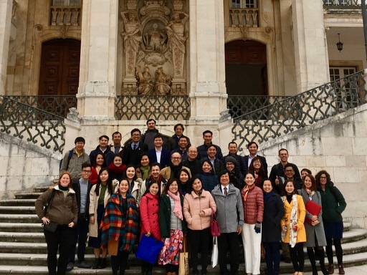
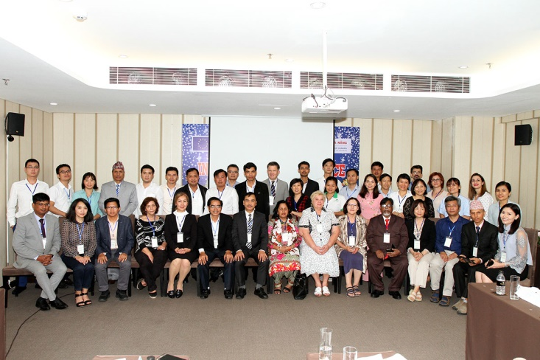
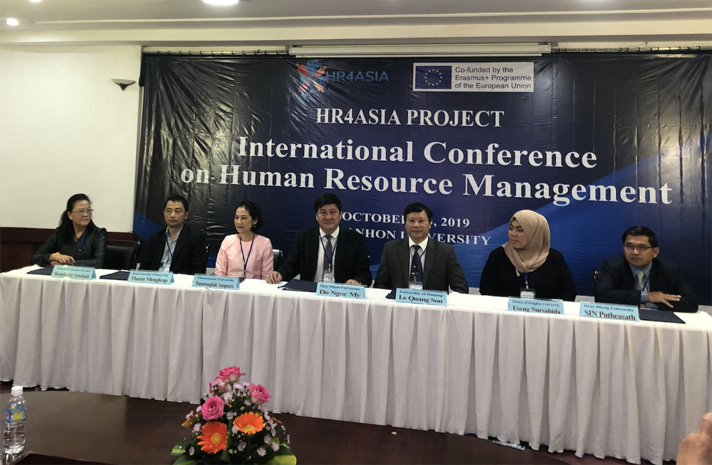
ERASMUS+ KA2: CAPACITY BUILDING
7
MESFIA - Mastering energy supply focusing on isolated areas
Coordinating Institution: Technological Educational Institute of Crete - Greece
Participating Institutions: 11
Funding: 951,297 Euro
Duration: 2018 – 2021
MOMA – Research-based curriculum development in molecular and materials sciences
Coordinating Institution: The Katholieke Universiteit Leuven - Belgium
Participating Institutions: 07
Funding: 999,695 Euro
Duration: 2019 – 2022
8
V2WORK: Study visit at Coimbra, Portugal
HUB4GROWTH: International Conference at Danang
HR4ASIA: International Conference in Quy Nhon

Slide 31
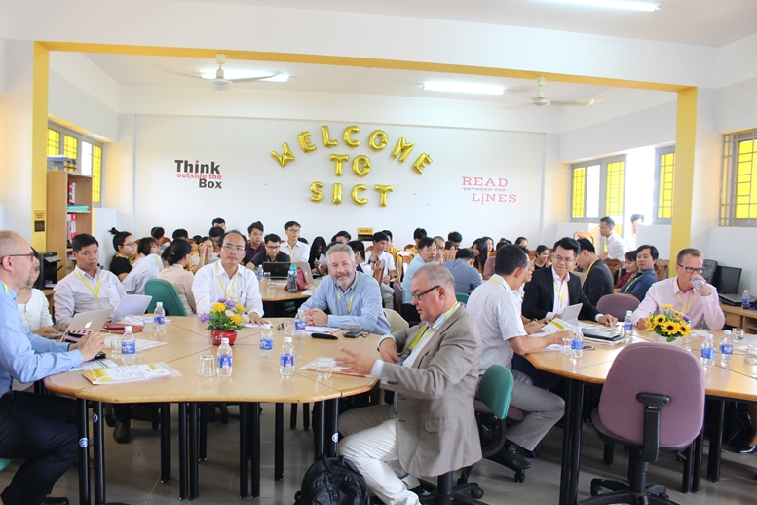
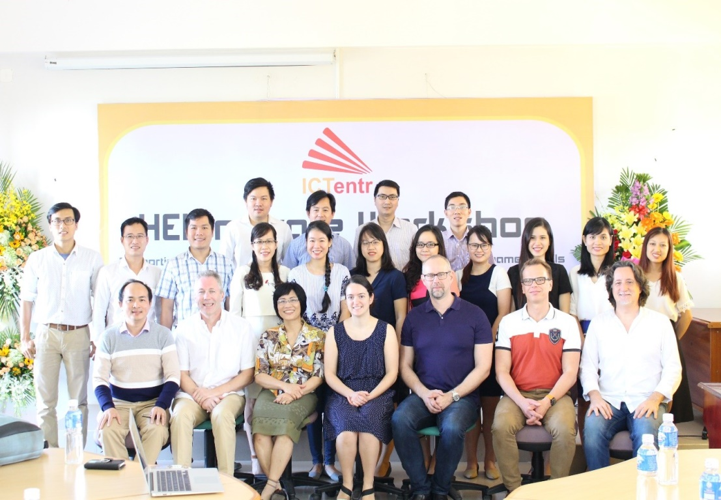
ERASMUS+ KA2: CAPACITY BUILDING
9
ICTentr - Supporting Entrepreneurial Development in the Field of IT in Vietnamese HEIs
Coordinating Institution: University of Turku
Participating Institutions: 5
Duration: 2015 – 2018

Slide 32
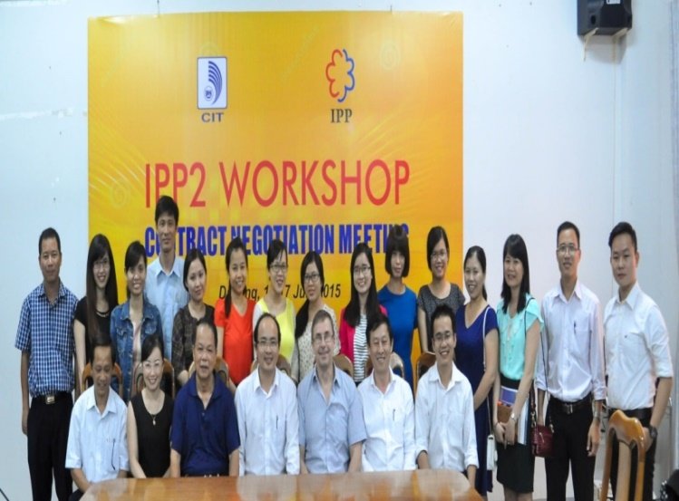
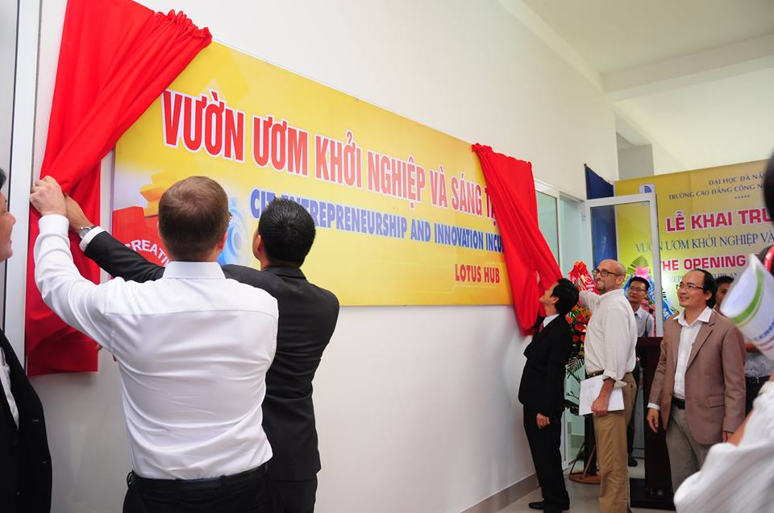
Other projects
IPP project
Objectives: Development of Entrepreneurship and Innovation in Danang city
Sponsorship: Innovation Partner Program of Finland – Vietnam
Results:
Establishing CIT incubator – Lotus Hub
Entrepreneurship training: Curriculum, materials, 16 pilot courses
Promoting and inspiring innovation and entrepreneurship: 27 Startup projects incubated, Network of 80 experts (trainers, mentors…) and 20 Organization partners
Events, information dissemination: 18 events motivating and inspiring for startups, 02 Startup clubs

Slide 33
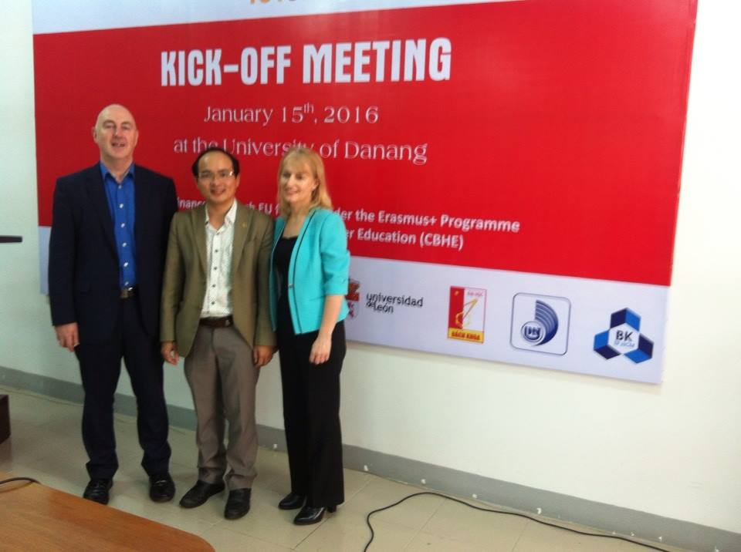
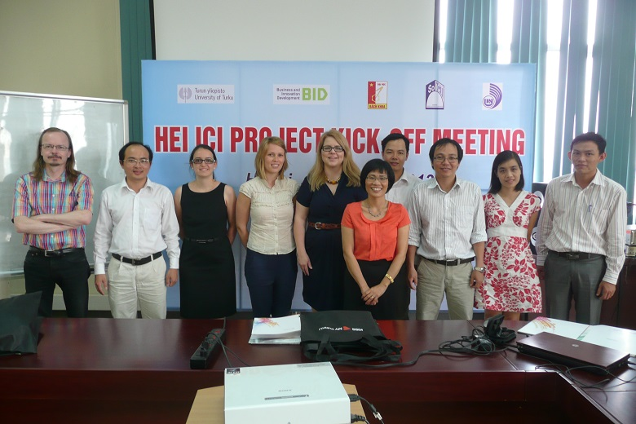
OTHER ACTIVITIES
ICTEDU project
Enhance the quality of higher education of ICT in Vietnam
Partners: Turku (Finland)

Slide 34
Challeges and suggestions
UD is a pubic university and its funding allocation by the government is low leading to inadequate capacity, resources
Internationalization of UD has been impeded by The COVID-19 pandemic leading to physical movement of students, staff has all been seriously affected
Some responsive policy and regulation have not kept up timely with the real context to foster the best practices in the management and administrative system
English proficiency of staff and students in some areas is not good as required
Number of in-bound and out-bound International students and staff is still limited
Some programs such as Advanced programs which reflects features of curriculum transposition rather than curriculum internationalization.
Financial difficulties of students in Central Region of Vietnam is not as good as the North and the South region

Slide 35
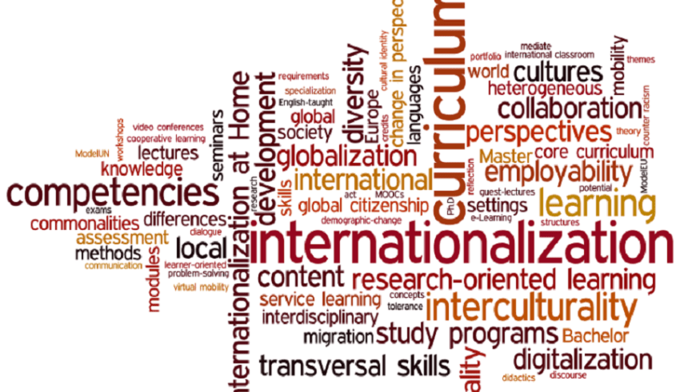
Challeges and suggestion
Acknowledge that internationalization is not only to improve the quality of the system but also to help the system better integrate in the region and in an international context
Breakthrough investment budget allocation for research to address the challenges
Invest more on academic and research activities to build a stronger internal system and appropriate strategies for internationalization. It also requires well prepared in terms of human and financial resources.
Internationalization is much more than international mobility and not limited to the exchange of students and staff.
Curriculum internationalization should be strengthened. Academic independence/autonomy should be motivated to revise the syllabus timely and internationally
Research become innovative and responsive to change to increase the performance of a complex research ecosystem for the country
Better practices in the management and administrative system; Integrate Top – down, bottom –up process, and the diverse of collaboration of all university actors – flat hierarchies
Maximize all opportunities to develop international cooperations, especially the wonderful projects of Erasmus +

