Slide 1
Internationalisation of Education

Slide 2
EdCIL BRIEF
Incorporated in 1981
Provides consultancy, advisory, digital, overseas education services
Privileged to be the only CPSE under Ministry of Education (MOE)
Continuously dividend paying and profitable
Turnover growth from INR 74 Cr. (FY’15) to INR 332.8 Cr. (FY’21)
PBT grown to INR 49.4 Cr (FY’20) from INR 7 Cr (FY’15)
Accorded Miniratna Category – I status in FY 2017

Slide 3
EDCIL VERTICALS
1
Study in India and Overseas Education
2
Digital Education Services
EdCIL
3
Education Infrastructure and Procurement Services
4
Online Testing and Assessment Services
5
Advisory Services
6
Skill Development Services
7
Technical Support Group

Slide 4
EDCIL GROWTH PATH
Revenue, INR crore

Slide 6
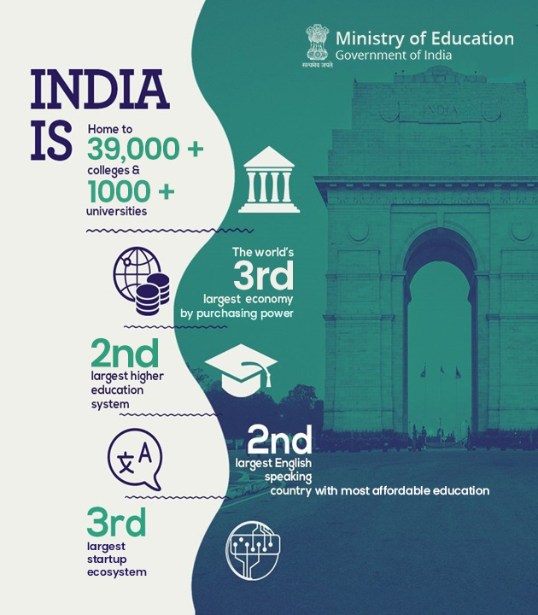

Slide 7
ABOUT ‘STUDY IN INDIA’ SCHEME
Initiative launched by Ministry of Education, Government of India, on 18th April 2018
EdCIL (India) Limited has been selected as the implementing agency for the scheme
Partner Institute : Quality Assurance through Ranking and Accreditation Frameworks - NIRF / NAAC. Selection of institutes on the basis of NAAC >= 3.26 (or) NIRF<=100
‘Study in India’ is a Government of India scheme powered by a One stop solution portal (www.studyinindia.gov.in) and 24*7 Contact Center

Slide 8
‘STUDY IN INDIA’ PROGRAM
Study in India Programme
2600+ Courses
160+ Premier Institutions
Secure and Vibrant Inclusive Environment
Tuition Fee Waivers
100,000
Seats
UG, PG, PhD Courses

Slide 9
‘STUDY IN INDIA’ – EXISTING FUNCTIONALITIES
SII Contact Centre – 24*7 support desk working on ‘Missed Call Campaign’ to support students
SIITracks – Study in India Tracking Software to disperse scholarship and stipends to students
OTP Integrated Platform – All the submissions on SII portal are verified using OTP for authenticity
Automated E-Mail and Business WhatsApp – Mapping of student journey
Document Verification of all the applicants via SII portal
Friday Webinar Series #FridayChatswithSII
Study in India Education Expos/Fairs
Digital promotions across the world using Google marketing platform - Facebook, Instagram, Twitter
Print Media - 20+ publications across targeted countries, 120+ insertions
Radio - SII Ads broadcasted in 50+ radio station across countries, 1000+ spots till now

Slide 10
MEDIA CHANNELS
How is Study in India Growing?
Radio
Radio
Newspaper
Newspaper
AY 2019-20
AY 2020-21
AY 2021-22

Slide 11
STUDY IN INDIA ADMISSION PROCESS
APPLICATION PROCESS
Student Registration
Account Activation via Email
Login and Account authentication via OTP
Completing Basic Information & Background Information
Choice filling by students
Document(s) Upload by students
Application Submission
COUNSELLING PROCESS
Institute is allocated to students through counselling process
Publishing of result on ‘Student Dashboard’ and ‘Institute Dashboard’
10-days window is provided to Institutes to verify the documents and accept/reject the eligible candidate(s)
Provisional Admission Letter by institutes on student dashboard and email.
STUDENT ONBOARDING
Students to accept/reject the admission to the allocated institute.
Visa can be applied only upon acceptance
The students details shared with respective Indian Mission abroad to facilitate visa
One SPOC is allocated from the institute to the students to help them prepare for the onboarding.

Slide 12
GROWTH OF ‘STUDY IN INDIA’
Key growth comparison of Study in India program
ACADEMIC YEAR
2018-19
Students Onboarded – 787
ACADEMIC YEAR
2019-20
Students Onboarded – 3142
ACADEMIC YEAR
2020-21
Students Onboarded – 3821
ACADEMIC YEAR
2021-22
Expected student to onboard - 5000
ACADEMIC YEAR
2022-23
Number of Students Submitted -1541
(Ongoing year, choice-filling is currently in progress)

Slide 13
India as a Destination for Niche Courses
Dance and Music
Indian Cuisine
Naturopathy
Yogic Sciences
Buddhist studies

Slide 14
PROPOSED TARGET COUNTRIES
European Countries | Malaysia | Nepal
Singapore | Japan | Bhutan
Australia | Philippines | Sri Lanka
United States | Thailand | UAE

Slide 15
UKIERI VIRTUAL MOBILITY PROGRAMME: STUDY IN INDIA
UKIERI stands for “UK-India Education Research Initiative” where nearly 400 UK students attended the short-term programmes (2-12 weeks) virtually across different SII partner institutions in AY 2020-21
PROGRAMME OBJECTIVES
Support the employability of UK graduates by recognizing the link between international experience and graduate employability
Support the Government of India ‘Study in India programme’ through the internationalization of Indian higher education institutions
Increase the levels of outward student mobility from the UK, in line with UUKi’s national campaign Go International: Stand Out to double undergraduate UK outward student mobility to 13% by 2020, and the EHEA target that 20% of graduates should have had an international experience by 2020

Slide 16
UKIERI VIRTUAL MOBILITY PROGRAMME: STUDY IN INDIA
All the approved short-term programmes were inclusive of :
Offer meaningful opportunities for students to develop intercultural understanding and, where relevant, discipline-specific skills and knowledge and enhance their employability
Be delivered in innovative and interactive virtual settings, allowing for collaboration between students and including activities such as:
o online seminars/webinars
o virtual tours
o group projects and presentations
o interviews
o virtual fieldwork
Be reciprocal, enabling valuable peer-to-peer interaction between UK and Indian students
Be inclusive, enabling students who may be unable to, or apprehensive of, international travel to participate in virtual programmes

Slide 17
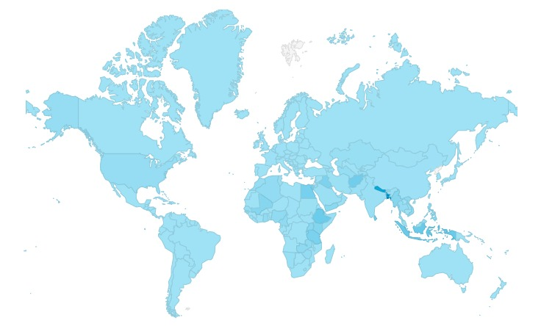
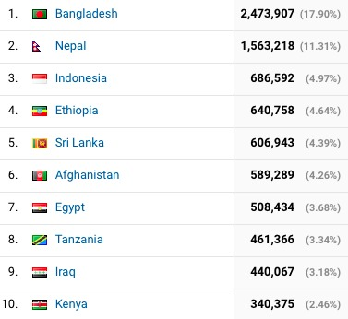
SII DIGITAL PRESENCE IN THE WORLD
All across the globe presence of the Study in India through Digital & offline events promotions in 180 countries- dominated by SAARC & Africa region
Country Name | Number of student visitors

Slide 18
EXPERIENCE OF STUDENTS UNDER SII SCHEME
Photograph of the month contest with SII Students
Every month we have different themes on which SII Students share their pictures & we feature the best pictures on SII social media

Slide 19
THANK YOU

