Slide 1
The ACU: Building a better world through higher education
Aditya Malkani
South & East Asia Representative

Slide 2
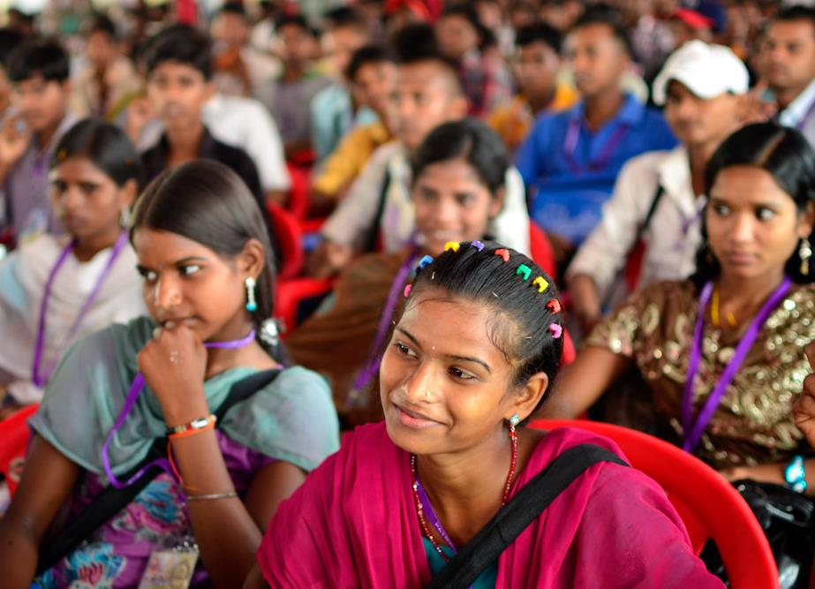
The ACU: a unique network of 500+ universities
across developed and developing countries
50+ countries
10 million+ students
500,000+ academic staff
500,000+ professional staff
66% of members in low and middle income countries
Two-thirds of the Commonwealth under 30
Notes:
The ACU is a university membership organisation; we are governed by our members.
500+ member universities
66% in low and middle income countries
5% in small states
Africa: 109 members (20%)
Asia: 261 members (50%)
Americas: 36 members (6%)
Australasia and the Pacific: 32 members (7%)
Europe: 90 members (17%)

Slide 3
Our track record
60+ years’ expertise managing multimillion-pound government scholarship schemes: Chevening, Commonwealth, Marshall, QECS
£31m in endowments
£10m+ project funding from governments, foundations, and corporate partners

Slide 4
Our partners

Slide 5
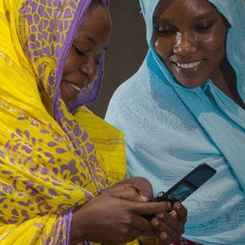
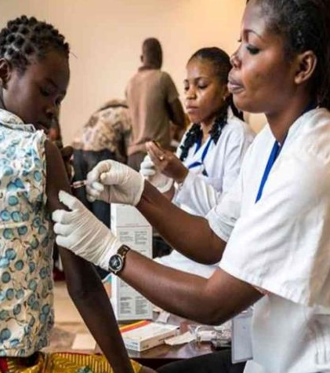
Our mission
To build a better world through
higher education
Notes:
The ACU’s mission is to build a better world through higher education.
We believe that international collaboration is central to this ambition. By bringing universities together from around the world – and the people who study and work within them ‒ we help to advance knowledge, promote understanding, broaden minds, and improve lives.

Slide 6
ACU digital now
Our commitment to ensuring that our vibrant global network continues to thrive
Using digital solutions to cross borders, narrow divides, and create access to inspire change
Inclusive, participatory, and wholly informed by our members
Creating virtual forums to share ideas and knowledge
Making more digital resources available
Transforming our grants to support online engagement and exchange

Slide 7
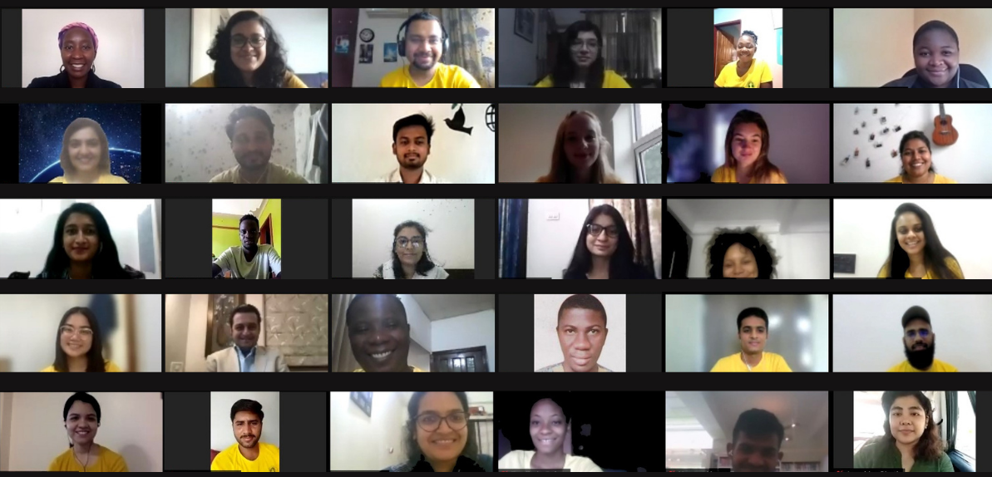
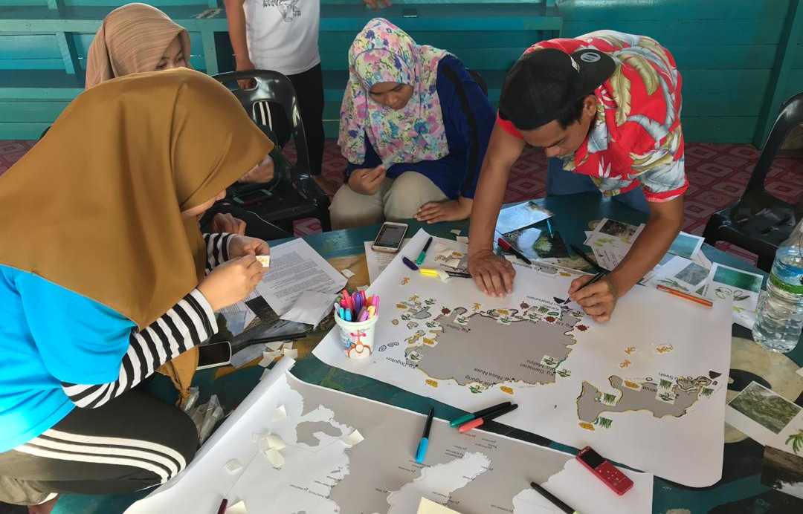
virtual forums and platforms for members to share ideas and knowledge
Ambassadors Summits
Virtual ACU Summer School 2020 & 2021
ACU Podcast – The Internationalist
The ACU Review
Funding opportunities to facilitate virtual collaborations
Notes:
Images:
Top: Students from ACU Summer School 2021
Bottom: Researchers at the University of Malaya ecosystem mapping with community based organisation – profiled as part of #UnisForOurPlanet campaign
ACU podcast – The Internationalist – features students, academics and practitioners from across the Commonwealth to address some of the biggest questions in higher education such as the digital transformation in higher education.
The ACU Review magazine celebrates and showcases the extraordinary work of member universities across the Commonwealth and their contribution to the world around them. Each issue explores a different theme, chosen to highlight the value of higher education to society, and to reflect the rich diversity and shared challenges that characterise the ACU's global network.
Virtual ACU Summer School on ‘Urban disasters’ with ACU member Tata Institute of Social Sciences

Slide 8
Virtual Mobility grants
Universiti Malaya and South Eastern University
KIIT University and Kampala International University
University of Derby and University of Education Winneba
Newcastle University and University of Nicosia
Western University and University of Rwanda

Slide 9
Commonwealth Virtual exchange pilot
50 UG students from 10 participating ACU members
Collaborative effort among ACU members
Pilot will enable strategy for expansion
8 weeks from October to December 2022

Slide 10
Educational opportunities that transform lives
Notes:
Image shows Kenyan Queen Elizabeth Commonwealth Scholar, Elly Wafula, who studied Medical Physics at the University of Malaya.
Queen Elizabeth Commonwealth Scholarships provide opportunities for Masters study in low and middle income countries. We would like to work with you to make sure your graduate students are aware of these opportunities.
Scholarships build capacity and extend opportunity – seeding change. With SDG4b, the global community also recognises that access to scholarships is transformative for both individuals and society.
The ACU is campaigning to increase the contributions to the QECS endowment fund.
Elly’s story: Elly arrived in Malaysia in 2019 to begin his MSc in the emerging field of Medical Physics. The award will train Elly to operate the finely calibrated medical equipment used in cancer screening, allowing him to work as a skilled hospital technician when he returns to Kenya. But Elly’s dreams are bigger than this. He also hopes to use his Queen Elizabeth Commonwealth Scholarship to build bridges between the University of Malaya, which has one of the world’s leading Medical Physics courses, and the University of Nairobi, so that the university can offer its own Master’s courses in Medical Physics. This way Kenya will be able to train its own medical physicians, boosting the number of homegrown skilled technicians in its healthcare system.

Slide 11
Thank you!
Contact details:
Aditya Malkani
South & East Asia Representative
aditya.malkani@acu.ac.uk

